Slide 1
Vision and plan for analytics & data science practice at zensar
Presented By
Nitin Kapoor

Slide 2



Analytics and data science PRACTICE - MISSION & GOALS
Practice Mission: We will be the best in delivering innovative industry-focused solutions with measurable business outcomes.
Business Growth
10% of Zensar's OB from Analytics & Data Science, in-line with industry norm. (up from the current ~4.5%)*
Portfolio Modernization
10% of Analytics & Data Science practice OB in 2019-20 from cloud data platforms and AI propositions (up from current ~0%)
Innovative Industry Solutions
10% of Analytics & Data Science practice OB in 2020-21 from each identified BIG BET
Goals
Stronger Alignment with Sales, Explore Inorganic Growth
Make Disproportionate Investments in Modern Technologies
Domain Led Solutions and Big Bets
*The plan for achieving this requires better understanding of and alignment to Zensar's overall growth strategy

Slide 3
Suggestive BIG BETS
The practice proposes to develop deep skills and technology solutions in key identified areas (‘Big Bets’) inline with Zensar’s strategy. Each big bet is expected to deliver atleast 10% of practice OB in 2020-21.
The below mentioned big bets are suggestions proposed for discussion and evaluation. The final solution ideas will be arrived upon from a better understanding of Zensar’s priority areas and in consultation with other stakeholders.
1
2
3
Industry 4.0 Analytics
Leverage Zensar's partnership with PTC ThingWorx to improve factory operations and productivity by using Artificial Intelligence techniques on IoT (and MES) data sets.
Personalized Shopper Engagement
Use deep learning techniques to discover personalization opportunities in targeting prospects and customers. Implement a closed loop digital marketing campaign.
Potential Partner: Adobe
Conversational AI for P&C Insurers
Improve operational productivity and customer experience by enabling AI powered voice bots. Customers can intelligently converse with the organization using voice.

Slide 4
Organization
The below team is expected to be partially billable
Industry solutions/ Big Bets may require additional investments based on business case
Global Practice Leader – Analytics & Data Science
Onsite Customer Engagement & Advisory
(Pre-Sales)
Solution Architecture (Consulting, Industry Solutions, Big Bets, Delivery Assurance)
Technology Group
(Consulting, Technical Competency)
Data Science
(AI, ML Competency)
ZenAnalytica
(Implement Solutions, POC’s, Big Bets, Platform)
Technical Sales Specialist – NA(2)
Mfg: Solution Architect (1) +Consultant (1)
Principal Information Architect (1)
Principal Data Scientists (1)
Project Manager/Solution Architect (1)
Technical Sales Specialist – UK(1)
Retail: Solution Architect (1) +Consultant (1)
DW & IM – Sr. Technical Architect (2)
Sr. Data Scientists (3)
Sr. Developers (5)
Technical Sales Specialist – SA(1)
Insurance: Solution Architect (1) +Consultant (1)
Big Data – Sr. Technical Architect (2)
Data Scientists (2)
Developers (8)
Others: Solution Architect (1) +Consultant (1)
Cloud Data Platform– Sr. Technical Architect (3)
Big Data/ Cloud- Administrator (1)
BI/EPM – Sr. Consultant (1)
Adv. Visualization – Consultant (1)
Alliances, Partnerships, Marketing (1)
PMO (1)

Slide 5
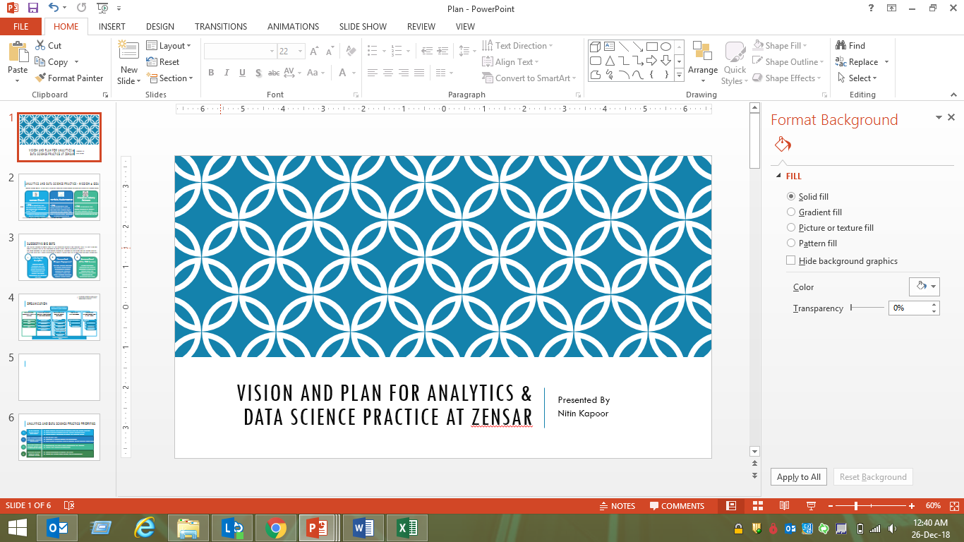
THANK YOU!

Slide 6
Analytics and data science PRACTICE Priorities
1
Be the Preferred Service Line for Sales Teams
Onsite technical sales to engage customers along with account managers
Regular interlocks between sales and practice leadership teams
Industry focused propositions, Marketing and pre-sales armory
2
Make Disproportionate Investments in Modern Technologies
Get the team right
Investments in trainings, software and infrastructure
Forge industry partnerships to win (& execute). Explore inorganic growth options
3
Build Deep Domain & Technical Capabilities in Identified BIG BETS
Conceptualize BIG BETS in Retail, Manufacturing and Insurance
Identify ‘pilot’ customer, co-development
4
Work With Delivery Teams to Ensure Customer Delight
Identify opportunities to cross-sell and up-sell
Identify and address project delivery risks early/effectively

